Slide 1
Wavecon Telecom Analysis
-- by Debarati Karmakar

Slide 2


Objective
Analyse the Dashboard and provide insights by addressing the Question.

Slide 3


Introduction
Wavecone , leading Telecom service provider in India , made a Significant change into 5G market . It launched in May,2022 in 15 Cities with 13 plans.
This Project highlights various Key Performance Indicators (KPIs) observed across the Country as a Result of Wavecon’s 5G Network service by comparing data collected before (January- April) and after (June-September) 5G rollout .

Slide 4



Key Performence Indicators
ARPU
Average Revenue
Per User
Reveneau
TAU
Total Active User
TUsU
Total Unsubscribe
User

Slide 5
Problem Statements
1
2
3
4
5
What is the impact of the 5G launch on our revenue?
Which KPI is underperforming after the 5G launch?
After the 5G launch, which plans are performing well in terms of revenue? Which plans are not performing well?
Is there any plan affected largely by the 5G launch? Should we continue or discontinue that plan?
Is there any plan that is discontinued after the 5G launch? What is the reason for it?

Slide 6

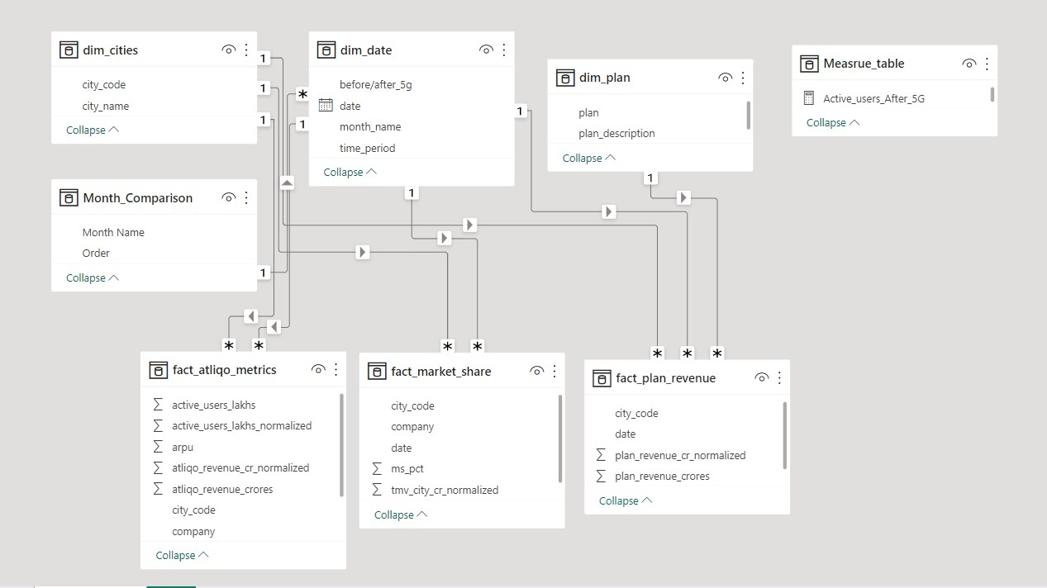
S-C-H-E-M-A

Slide 7

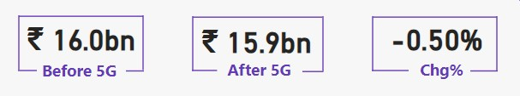
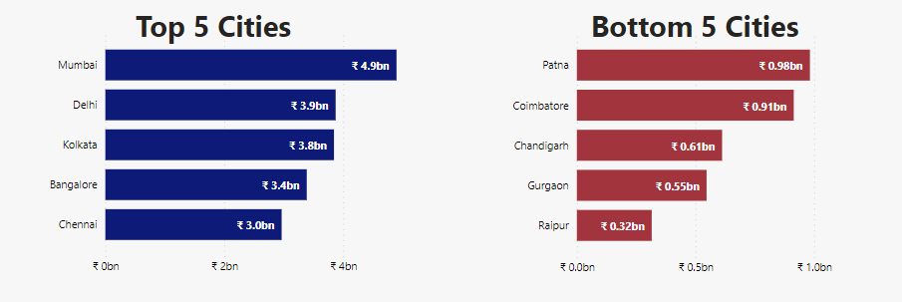
1. What is the impact of the 5G launch on our revenue?

Slide 8


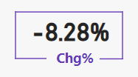


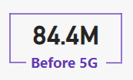
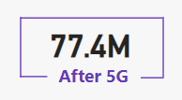
2. Which KPI is underperforming after the 5G launch?
ACTIVE USERS
Chenge in Active User
Total Active User

Slide 9
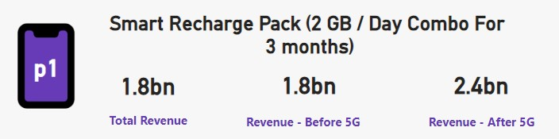
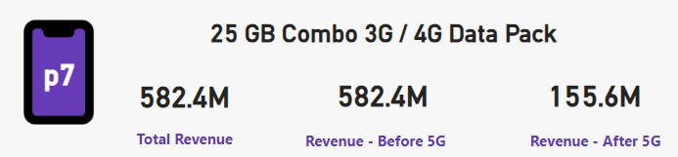
3. After the 5G launch, which plans are performing well in terms of revenue? Which plans are not performing well?
Top Performing Plan
33.33% Increase
Least Performing Plan
73.28% decrease

Slide 10

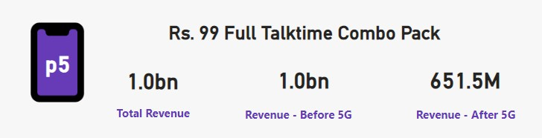


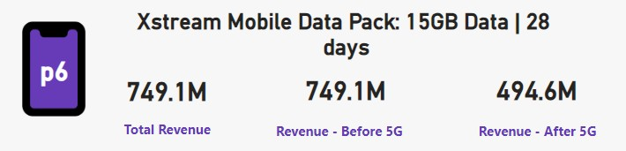




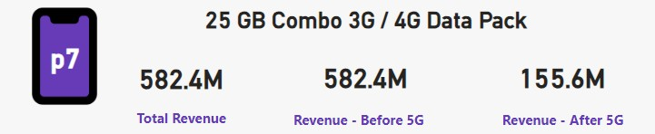
4. Is there any plan affected largely by the 5G launch? Should we continue or discontinue that plan?
35.12%
Significant Decrease in Revenue for plan p5, p6, p7
33.91%%
73.28%

Slide 11

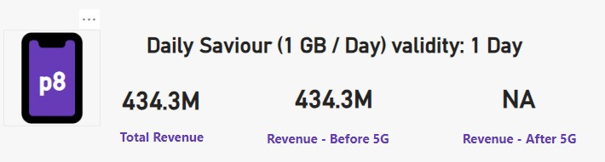
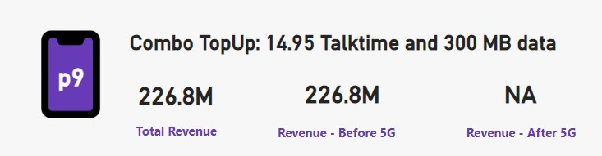
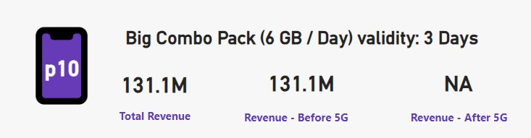
5. Is there any plan that is discontinued after the 5G launch? What is the reason for it?
1GB of data Might not be Sufficient for many Users’ need especially for those who does streaming, download etc.
Talktime of 15 mints would not be
sufficient for the Customer who makes lots of voice calls
Mejority of customer may not need or use for 6GB per day, which can be excessive

Slide 12


Recomendation
Introduce more 5g enabled Data Plans with higher value and permium service.
Prioritize 5G rollout more in urban area and business hub for high speed Connectivity.
Smooth upgradation process and impleament strong feedback system.
Collaborate with Educational Institute to offer Discount to student and Educators.
Offer Affordable and Seamless 5g International roaming pack for Travelers by doing tie-up with International Service Provider.
Promoting Low-latency 5G connection for Cloud and mobile Gaming
Implement Loyalty Program that rewords Long term subscribe with Discount, Exclusive Access to content etc.

Slide 13

--Thank You !!
5G can change everything, but there needs to be
a comprehensive information campaign for businesses and consumers.

